Slide 1
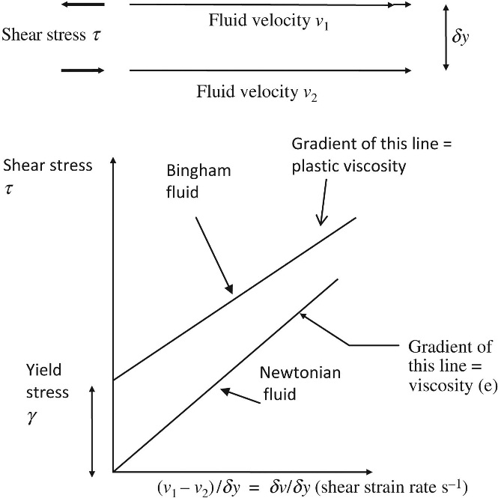
FIGURE 8.1 Definition of Viscosity

Slide 2
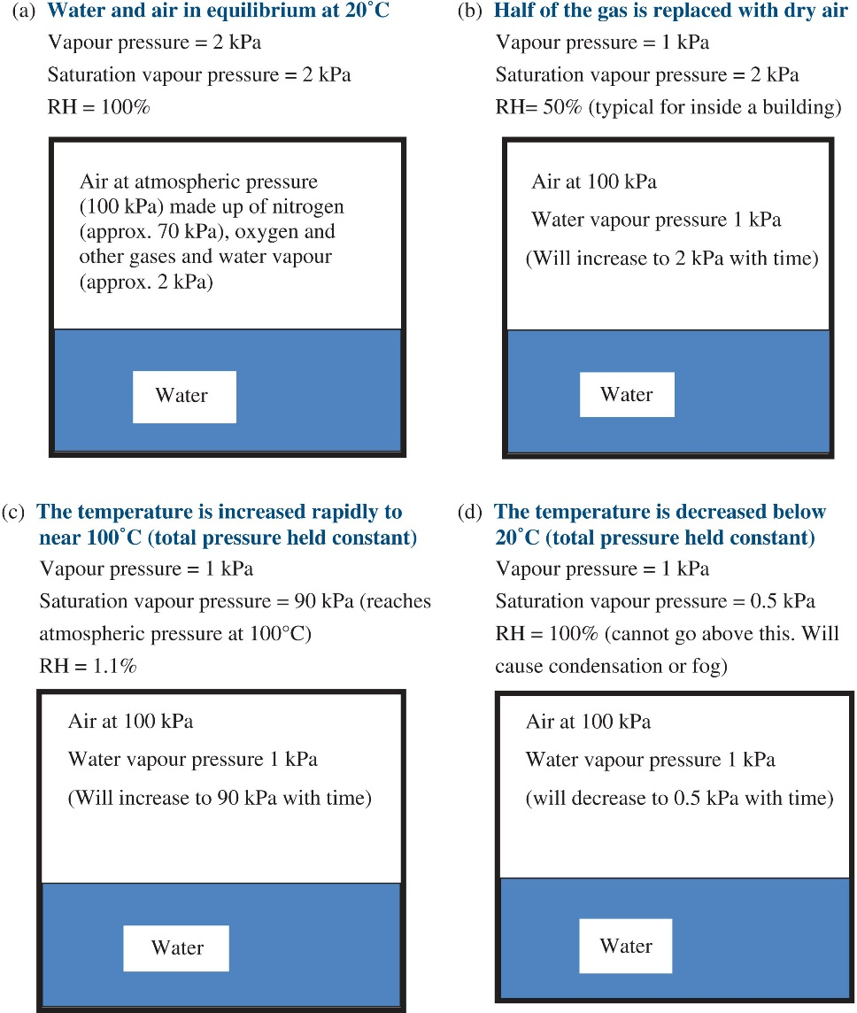
FIGURE 8.2 Water and Water Vapour in a Sealed Container

Slide 3
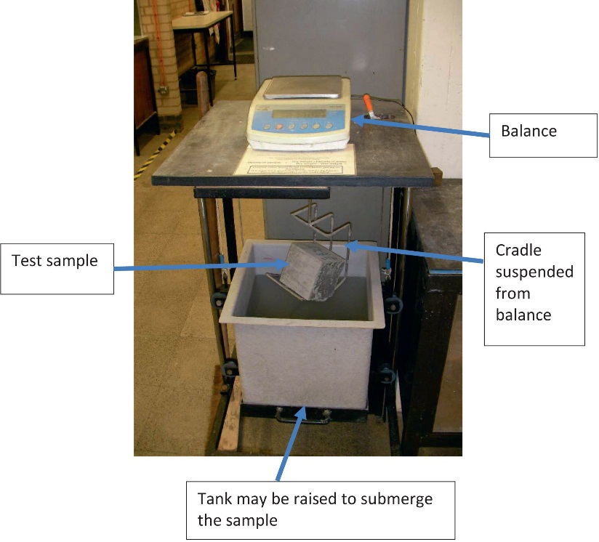
FIGURE 8.3 Balance for Measuring Mass and Density

